Slide 1
Population genomics
RNA-seq
Eyal Privman
Department of Ecology and Evolution, University of Lausanne
PhD Summer School
June 2012

Slide 2
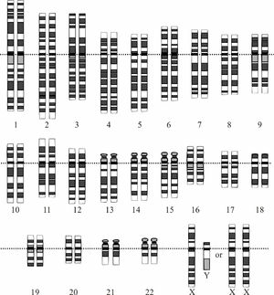
Population genomics
Population genetics:
The study of allele frequency distribution and change under the influence of evolutionary processes:
genetic drift
mutation
natural selection
recombination
gene flow
(Wikipedia)
Genomics

Slide 3
Population genomics: applications
Reconstruct demographic history
Population expansion; bottlenecks; founder effect
Migration / invasion (fire ants, pharaoh ants, humans, flies…)
Ascunce et al. Science 2011

Slide 4
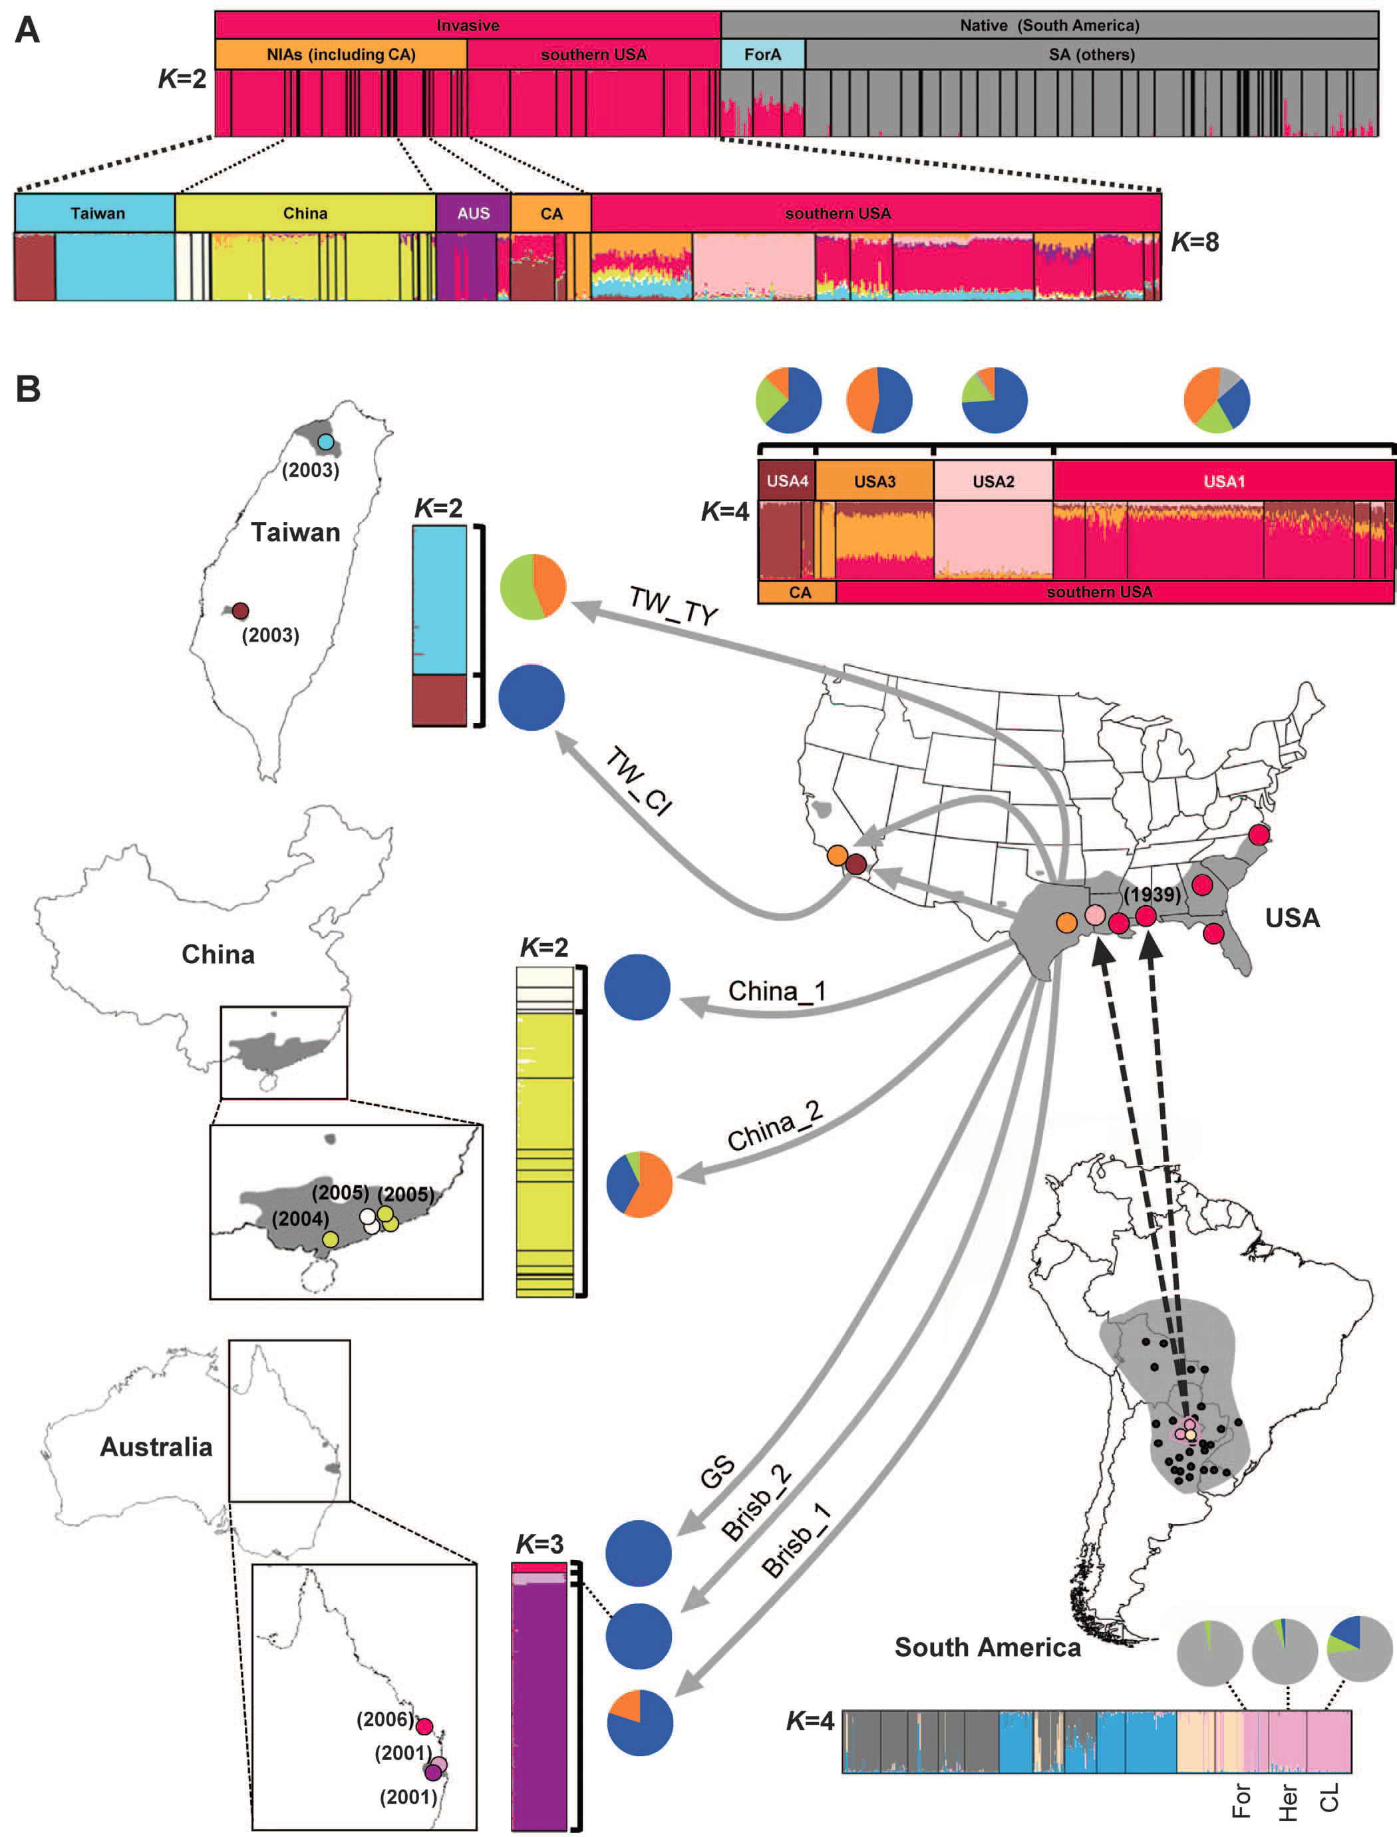
Population genomics: applications
Reconstruct demographic history
Population expansion; bottlenecks; founder effect
Migration / invasion (fire ants, pharaoh ants, humans, flies…)
Ascunce et al. Science 2011

Slide 5
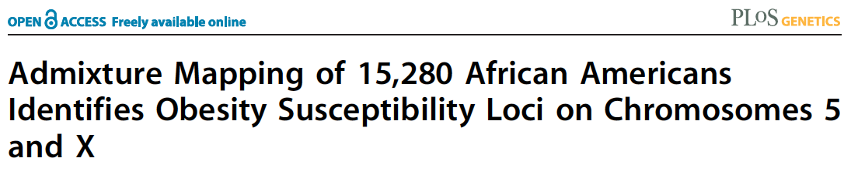
Population genomics: applications
Reconstruct demographic history
Population expansion; bottlenecks; founder effect
Migration / invasion (fire ants, humans, flies…)
Admixture of populations (African Americans)
Genomics
Cheng et al. 2009

Slide 6
Population genomics: applications
Reconstruct demographic history
Population expansion; bottlenecks; founder effect
Migration / invasion (fire ants, humans, flies…)
Admixture of populations (African Americans)
Association studies – linking genotype & phenotype
Genome-Wide Association Studies (GWAS)
Admixture mapping
Quantitative Trait Loci (QTL) mapping; hybrid cross
Detect selection
Local adaptation (F_{ST})
Selective sweep

Slide 7
Population genomic data
SNP-chips
RNA-seq
RAD-seq
Whole genome seq?

Slide 8
SNP discovery and genotyping from RNA-seq
Short read RNA-seq assembled de novo or aligned to ref genome
Each sample may contain one allele (haploid), two (diploid) or more, as in our case of pooled samples:
Fire ant RNA-seq data mapped to genome:
5 males = 5 alleles
4 queens = 8 alleles
200 workers = 400 alleles
Note: this is not a “proper” population sample
It’s more useful to sequence individual separately
It’s more useful to detect SNPs using large cohorts of sequenced individuals

Slide 9
SAMtools
Process SAM (Sequence Alignment/Map) and BAM format (compressed binary version of SAM)
E.g. Process Bowtie or TopHat alignments of RNA-seq or RAD-seq to a reference genome
Use the manual page to write samtools command lines: http://samtools.sourceforge.net/samtools.shtml

Slide 10
Convert BAM to SAM
Use samtools view to convert the binary format to readable text:
$ samtools view W422.accepted_hits.sort.bam | head
R2D2_0117:2:44:1714:17921#0 16 SIgn00001 79 50 75M * 0 0 ATTAAGTTCTAGTTCAAATAACTTAGGATTGTCTGTTGTATAGCTCACAAGCATGACGTAACCATTTGGTCCACG HHHHHFGGFGEDHHHHFHFHHBHDHHHHHHHHHHGGGGGD3HHHHHFHHHGGG>GGHHHGGHHHHGHHHHEHHHH XA:i:0 MD:Z:75 NM:i:0 NH:i:1
R2D2_0117:2:2:9366:2587#0 16 SIgn00001 96 50 75M * 0 0 ATAACTTAGGATTGTCTGTTGTATAGCTCACAAGCATGACGTAACCATTTGGTCCACGAACTTCCTGTATACCTG IIIGIIIIIIIHIIHIIIIIIIIIIIIIIHIHIIHIIIFIIIIIIIIIIIIIIIIIIIIIIIIIIIIIIIHHIII XA:i:0 MD:Z:75 NM:i:0 NH:i:1
R2D2_0117:2:26:7962:5823#0 16 SIgn00001 101 50 75M * 0 0 TTAGGATTGTCTGTTGTATAGCTCACAAGCATGACGTAACCATTTGGTCCACGAACTTCCTGTATACCTGTCTTA IIIIIIIIHHDGDDBIGGIIIIHIHIIIIIIIIHIIIIFIIIIIIIIIIIGIIIIIIIIIIIIIIIIIIIIHIII XA:i:0 MD:Z:75 NM:i:0 NH:i:1
R2D2_0117:2:75:3630:14196#0 0 SIgn00001 113 50 75M * 0 0 GTTGTATAGCTCACAAGCATGACGTAACCATTTGGTCCACGAACTTCCTGTATACCTGTCTTAGTCTTGTTCTTA HIIHIIIIHIIIIIIIIIIIIIHIFIIIIHHIIIHIIHFIIEGIIIIIIIIIHIHIHIHHIIIIIIIIIIIIHIG XA:i:0 MD:Z:75 NM:i:0 NH:i:1
...
...

Slide 11
Convert BAM to SAM
samtools view can cut a desired region for us:
(Note: BAM file needs to be sorted)
$ samtools view W422.accepted_hits.sort.bam SIgn00002:100,000-110,000
R2D2_0117:2:68:6557:15142#0 0 SIgn00002 108809 50 75M * 0 0 CTTAGAACTCATCATGTCTCACAATATACGCATCGCAAAACAGAAATTATCATCTATGGATCGAGGGTAAGCGTC IIIIIIIIIIIIIIIIIIIIIIIIIIIIIIIIIIIIIIIIIIIIIIIIHIIIIIIIIIIIIIIIIIIDHIIIIGI XA:i:0 MD:Z:75 NM:i:0 NH:i:1
R2D2_0117:2:116:5195:5494#0 0 SIgn00002 109328 50 75M * 0 0 GTCGGCAATACTTTAGTGATCGCGGCTGTAATTACCACGAGGAGATTACGGTCTGTGACTAATTGTTACGTGTCT IIIDIIIIIIIIIIIIIIIIIIHIIIHHEIIIIIIIIIHFIIEIGIIIIIIGIEIBG+GGEEIIIGIIIIGHFHI XA:i:1 MD:Z:67T7 NM:i:1 NH:i:1
R2D2_0117:2:60:3752:12219#0 16 SIgn00002 109341 50 75M * 0 0 TAGTGATCGCGGCTGTAATTACCACGAGGAGATTACGGTCTGTGACTAATTGTTTCGTGTCTAGCTTGGCTGCTG EHIIIIGIHIIHFHIIIIIIGIIGIIIIIIIIHIIIIIIIIIIIIIIHIIIIIIIIIIIIIIIIHIIIIDIIIII XA:i:0 MD:Z:75 NM:i:0 NH:i:1
R2D2_0117:2:26:8854:8712#0 16 SIgn00002 109374 50 75M * 0 0 TACGGTCTGTGACTAATTGTTACGTGTCTAGCTTGGCTGCTGCAGATTTACTGGTCGGTCTAGCGGTGATGCCAC IDIHIIIIHIIGIHHHIIIIHGIIIIDIHIGIHHIIIIIIIIIIIIIIIIIIIIIIIIIHGIIIIIIIIIIIIII XA:i:1 MD:Z:21T53 NM:i:1 NH:i:1

Slide 12
Combine, sort, index BAM files
Concatenate: samtools cat combines several files into one:
$ samtools cat *.bam > all.bam
(Note: SAMtools commands were designed for combination by UNIX pipes)
Sort: Use samtools sort to sort the data in a BAM file: (needed before indexing)
$ samtools sort W422.bam W422.sort
(Note: the “.bam” suffix will be added to the output parameter)
Index: samtools index creates an index file for a (sorted!) BAM file that allows instantaneous access to individual records:
$ samtools index W422.sort.bam
Merge: samtools merge combines (sorted!) BAM files:
$ samtools merge merge.sort.bam *.sort.bam
* Note: When merging files you may need to correct the header information and read group (RG) information. See exercise instructions.

Slide 13
GATK
Package for population genomics from the BROAD Institute: http://www.broadinstitute.org/gsa/wiki/index.php/Main_Page (used in the 1000 genomes project)
Disclaimer: GATK (and others) were designed for genotyping diploid individuals only.
We will use them to genotype pools with >2 alleles, which does not fit with the probabilistic model used.
So our best are pools of 5 males (haploids)

Slide 14
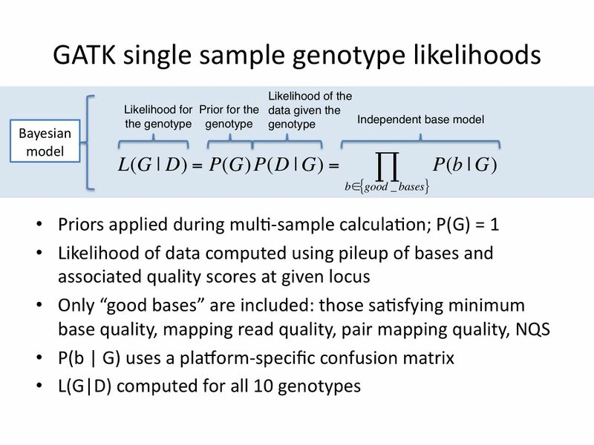

Slide 15
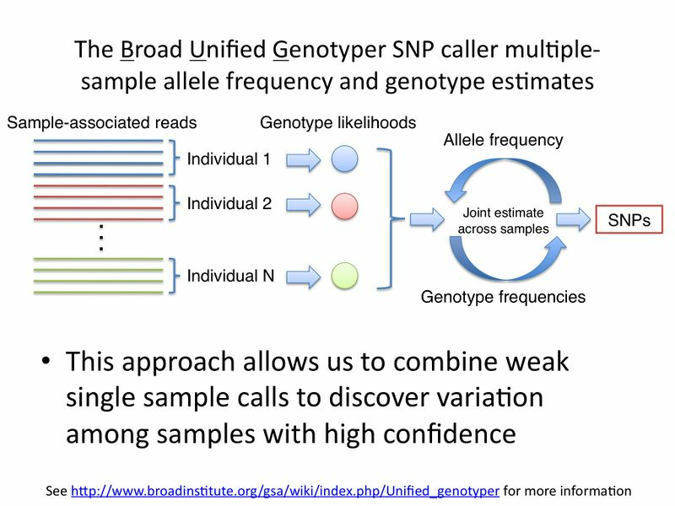

Slide 16
Genotype: the Unified Genotyper
The main program for genotyping SNPs:http://www.broadinstitute.org/gsa/wiki/index.php/Unified_genotyper
Example usage: http://www.broadinstitute.org/gsa/gatkdocs/release/org_broadinstitute_sting_gatk_walkers_genotyper_UnifiedGenotyper.html
Example usage: http://www.broadinstitute.org/gsa/gatkdocs/release/org_broadinstitute_sting_gatk_walkers_genotyper_UnifiedGenotyper.html

Slide 17
Genotype: the Unified Genotyper
The UnifiedGenotyper function in GenomeAnalysisTK detects SNPs and genotypes samples:
$ java -jar $GATK_HOME/GenomeAnalysisTK.jar \
-R SINV_subset_1.fa \
-I M350B.accepted_hits.sort.rg.bam \
-T UnifiedGenotyper \
-o M350B.accepted_hits.sort.rg.bam.snps.raw.vcf
(Note: Assumes the BAM file is sorted and indexed)
(Note: Requires read group information and corresponding header lines. See exercise instructions)
This will analyze one sample. The same command can be used for multiple samples.

Slide 18
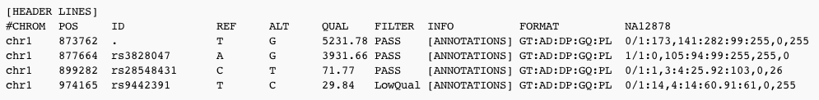
The VCF output format
GATK outputs a VCF (Variant Call Format) file:
QUAL: The Phred scaled probability that REF/ALT polymorphism exists given sequencing data.
Default threshold is 30.0
Format field names describe the next list of values:
GT (genotype): 0/1 means heterozygote ref/alt
DP (depth): total number of reads mapped
AD (allele depth): count of ref/alt alleles
Notes:
Because the Phred scale is -10 * log(1-p), a value of 10 indicates a 1 in 10 chance of error, while a 100 indicates a 1 in 10^10 chance. The GATK values can grow very large when lots of NGS data is used to call.
chr1 899282 rs28548431 C T [CLIPPED] GT:AD:DP:GQ:PL 0/1:1,3:4:25.92:103,0,26
At this site, the called genotype is GT = 0/1, which is C/T. The confidence isn't so good (GQ=25.92), largely because there were only a total of 4 reads at this site (DP=4), 1 of which was ref and 3 of which were alt (AD=1,3). The lack of certainty is evident in the PL field, where 0/1 = 0 (the normalized value), whereas there's a serious chance that she's hom-var 1/1 = 26 = 10^(-2.6) = 0.25%. Either way, though, it's clear that she's definitely not homozygous reference here 0/0 = 103 = 10^(-10.3) which is a very small number.

